Slide 1
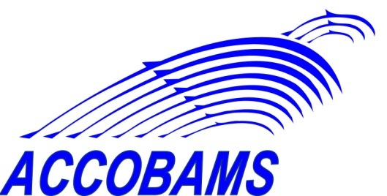
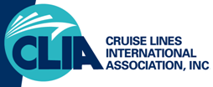
Cetaceans Strikes Avoidance – Cruise Industry Perspective
by Stanislav Kozhuharov,
Marine Superintendent, V.Ships Leisure
on behalf of the Cruise Lines International Association
IWC/ACCOBAMS Workshop
Beaulieu, 21-24 Sept 2010

Slide 2
Cruise Industry Policies Presentation
CLIA (Cruise Lines International Association) – world’s largest cruise association ~ 24 North America serving cruise lines
IAATO (International Association of Antarctic Tour Operators) ~ 46 cruise lines / operators members
AECO (Association of Arctic Expedition Cruise Operators) ~ 15 cruise lines / operators members
Others (V.Ships Leisure) – world’s largest ship manager ~ 12managed cruise owners
All of them aware of the potential issue and provided with relevant awareness / training guidelines
A number of cruise lines - members of all or some of the above associations

Slide 3
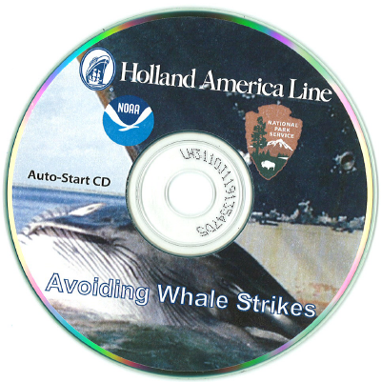
Training / Awareness Guidelines
USA NFMS/NOAA and Holland America Line (HAL) Training
CLIA Recommended Standard
HAL mandatory training
DVD available for use by other CLIA members
available for free also for direct use online: http://www.nmfs.noaa.gov/ole/about/video/hal_whale_strike/index.htm

Slide 4
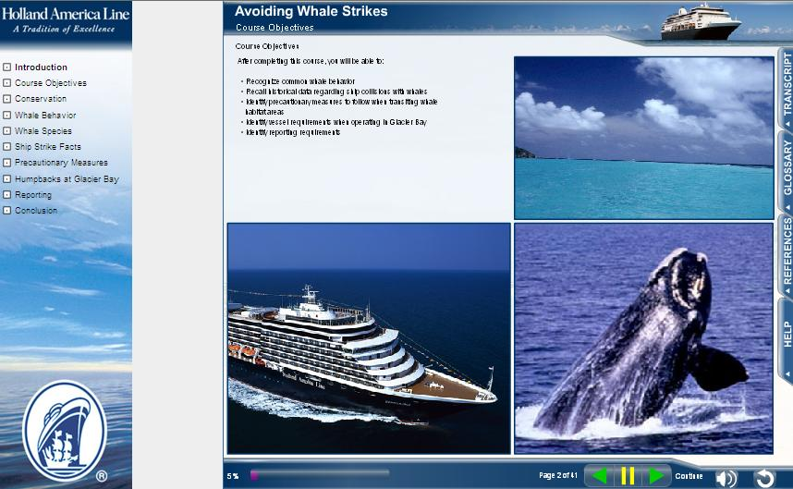

Slide 5
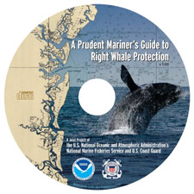
Training / Awareness Guidelines
NOAA/USCG – A prudent Mariner’s Guide to Right Whale Protection
available as a free download online for CD creation: http://www.nero.noaa.gov/shipstrike/doc/NOAA-RightWhalesCD.iso
another Industry Standard (V.Ships Leisure – mandatory training for Bridge teams before visiting affected areas)

Slide 7
Training / Awareness Guidelines
IAATO’s Marine Wildlife Watching Guidelines
vessels
zodiacs (inflatable dingies)

Slide 8
Training / Awareness Guidelines
AECO’s Guidelines for Expedition Cruise Operations in the Arctic
operators
visitors

Slide 9
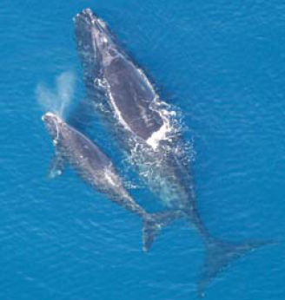
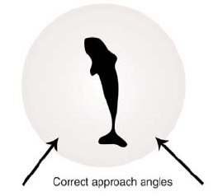
Training / Awareness Guidelines
Common items:
potential ship’s impact on cetaceans
recognizing cetaceans:
types
behavioural pattern
vessel’s correct code of conduct including:
voyage planning
lookout
avoidance or
correct approach angles
minimum distance
speed reduction / propulsion in
reporting strikes or sightings

Slide 10
Training / Awareness Guidelines
Form of Guidelines:
Interactive / CBTs (NOAA & NMFS/HAL)
tests / acquired knowledge assessments included
certificates for completion
leaflets / posters
IAATO
USCG/NOAA
AECO
referenced in the cruise line’s Management Systems
extended also to passengers (IAATO, AECO)

Slide 11
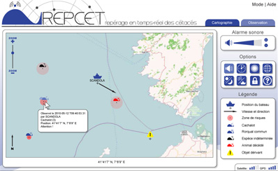
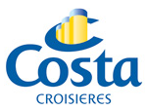
Other projects
REPCET –Pelagos sanctuary in the Mediterranean -participating ships report cetaceans sightings to each other via software and predict danger zones for collisions
http://www.repcet.com/partenaires
CLIA member participant partner – Costa cruises

Slide 12
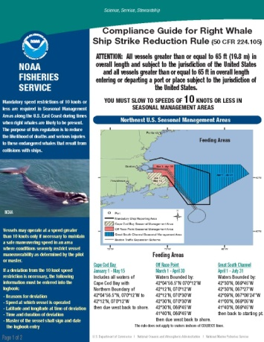
Compliance with regulations
required for the cruise lines by legislation or voluntarily accepted ISO standards (9001, 14001)
best management practices adoption through memberships associations
most known national whale strike avoidance regulations:
ECUSA:
mandatory reporting system and speed reduction
enforced via the US CFR
compliance with local environmental regulations can be a challenge to be aware of and interpret correctly

Slide 13
Conclusion
Cruise industry aware of the issue and provides guidance and training
Operational aspects could conflict:
avoidance – aim of regular/scheduled cruising operations
approach/ sighting - aim of expedition cruising
Items to be investigated and further clarified:
data for strikes by cruise ships?
strike reporting – legal aspects?

Slide 14
Other items for discussion
Maritime best management practices and techniques for cetaceans strike avoidance unified and promulgated by IMO in continuation to res. MEPC.1/Circ.647
Establishing Sightings Reporting systems and Speed reduction areas and indicating them on nautical charts
Implementation of technical means:
detection
sightings reporting
avoidance
Dissemination of local regulations and making them widely available and in English
Regulations on international level

Slide 15
Questions?
Thank you

